Slide 1

STOCK MARKET
TEAM MEMBERS:-
IZHAR BAGWAN
JAY PATEL
JHANSI CHALLA
KIRAN CHINNASWAMY

Slide 2
CONTENT
Introduction
Problem Statement
Technologies
Module
Architecture
Users
Screenshots

Slide 3
INTRODUCTION
Nowadays, stock market is highly influenced. Anyone who want to buy or sell shares of publicly listed companies can buy in just one click. A platform of exchanging shares.

Slide 4
PROBLEM STATEMENT
The stock market is the web application where the users should be accessible to buy the stocks and the admin should have access to modify/update the stocks.

Slide 5
TECHNOLOGIES
Front End : HTML, CSS, JavaScript
Back End : Java 9
Database : MySQL

Slide 6


MODULE
Admin
User

Slide 7
ARCHITECTURE
Login:
Username
password
NO
New user
YES
Register here
YES
Welcome to stock market

Slide 8
USERS
ADMIN
Login
Maintain Stock Category
Manage Transactions
Manage Orders
USER
Register on website
Browse Stocks
Buy Stocks
Order History

Slide 9
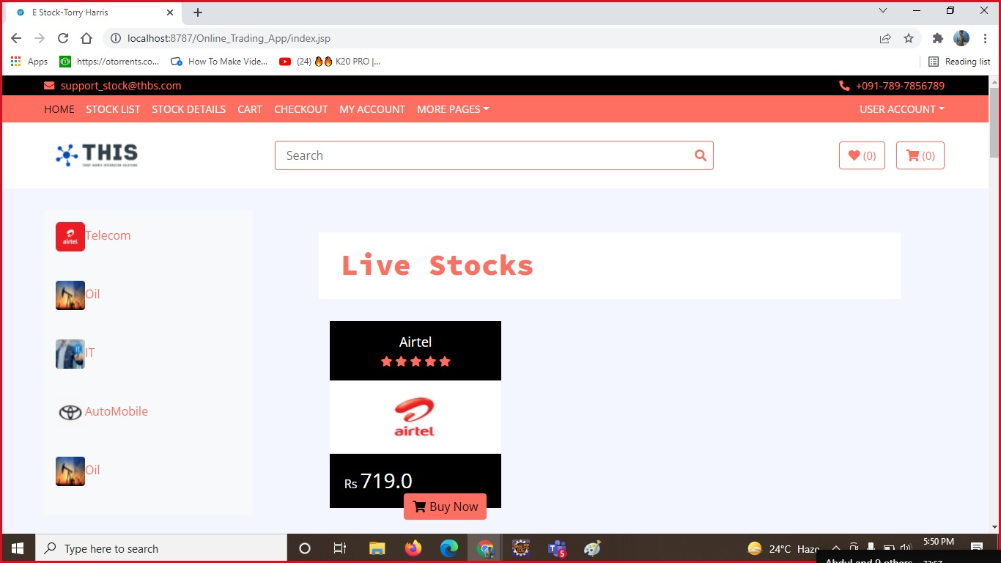
SCREENSHOT
Home Page

Slide 10
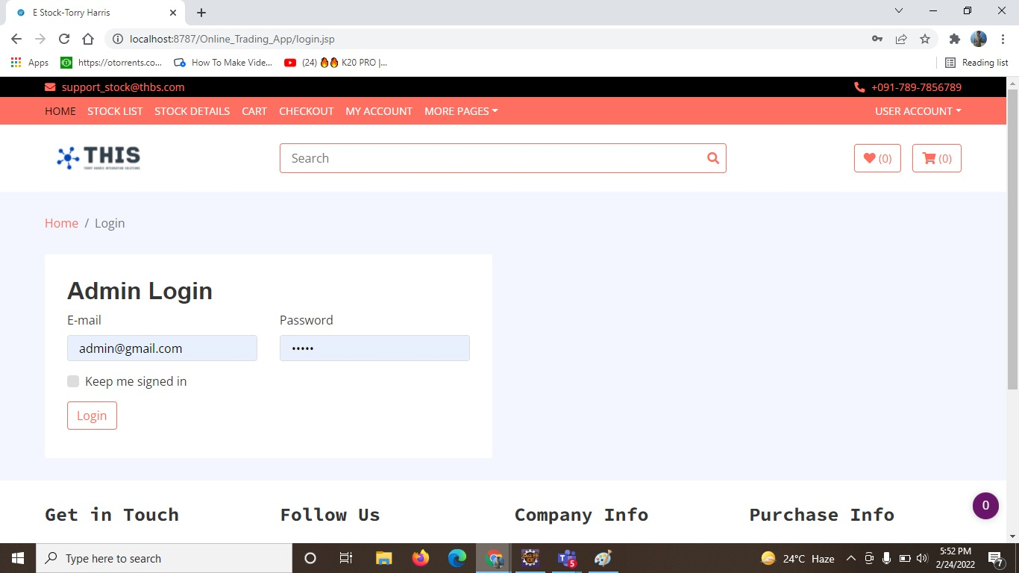
Admin Login Page

Slide 11
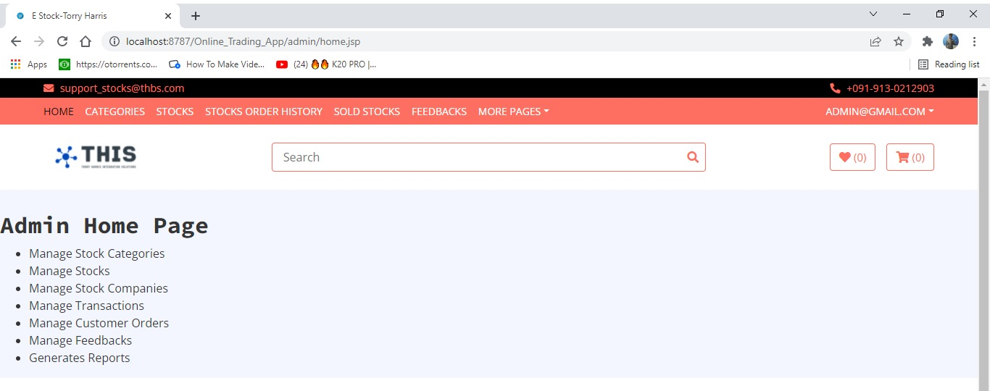
Admin Home Page

Slide 12
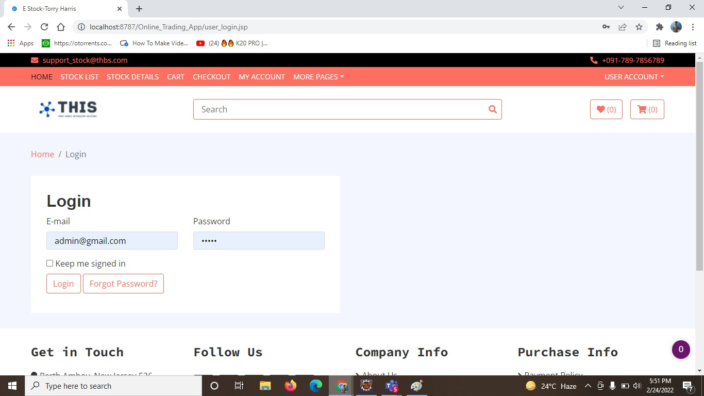
User Login Page

Slide 13
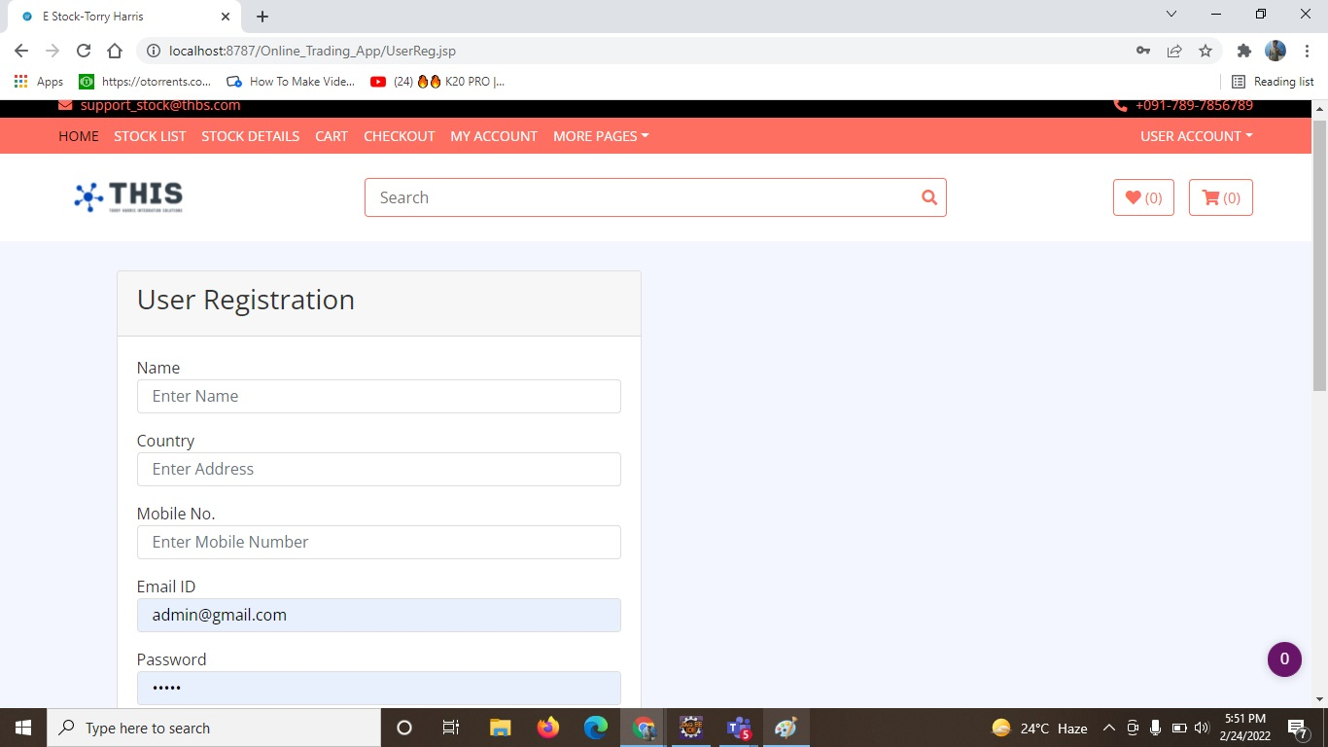
User Register Page

Slide 14


